Slide 1
HMAC Encryption Algorithms and Hash Functions
Presented by :
Bibek Tajpuriya
Manisha Dahal
Nayuma Karki
Ronit Karki
Swastika Bhattarai

Slide 2
INTRODUCTION to HMAC
HMAC (Hash-based Message Authentication Code) : A cryptographic authentication algorithm that combines a cryptographic hash function with a secret key to generate a message authentication code.
The secret key is known only to the sender and the receiver.
Key features of HMAC:
Security: Provides security against certain cryptographic attacks, such as length extension attack.
Flexibility: Can be used with various cryptographic hash functions, such as SHA-256 or SHA-512, allowing for flexibility in choosing the appropriate level of security and efficiency.
Efficiency: Despite its enhanced security features, HMAC remains computationally efficient, making it suitable for use in various cryptographic applications.
Application of HMAC : Commonly used in secure communication protocols for message authentication and integrity verification and also utilized in digital signatures, API authentication, etc.

Slide 3
Hash functions : Foundations of HMAC
Hash function: Mathematical function for transforming input into fixed-size output.
Purpose: Ensures data integrity, stores passwords securely, facilitates digital signatures.
Input: Message or data to be hashed.
Output: Fixed-size string of bytes, known as hash value or hash code.
Widely used in computer science and cryptography.
Applications: Data integrity verification, password storage, digital signatures.
Properties: Deterministic, fast computation, pre-image resistance, collision resistance.
Some common hash functions are:
MD5 (Message Digest Algorithm 5) : Widely used cryptographic hash function that produces a 128-bit hash value.
SHA-1 (Secure Hash Algorithm 1) : Produces a 160-bit hash value.
Other hash function include: SHA-256, SHA-384, SHA-512, BLAKE2, Whirlpool, etc.

Slide 4
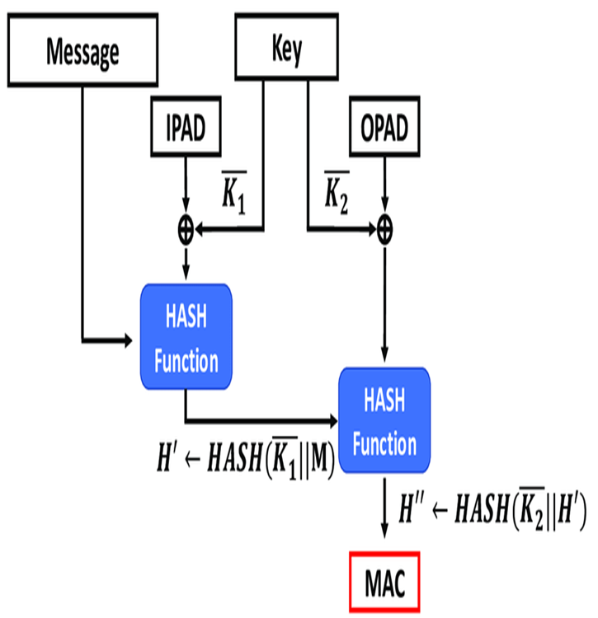
HMAC Algorithm
Inputs: HMAC takes two inputs: a message to be authenticated and a secret key known only to the sender and the receiver.
Key Padding: If the key is shorter than the block size of the hash function, it is padded to match the block size. If it is longer, it is hashed first.
Inner Padding: The key is XORed with a specific constant ("ipad") to create an inner padding.
Outer Padding: The key is XORed with another constant ("opad") to create an outer padding.
Concatenation and Hashing: The inner padding is concatenated with the message and hashed using the chosen hash function. Then the outer padding is concatenated with the hash result and hashed again.
Output: The final hash output is the HMAC.
Fig : HMAC algorithm

Slide 5
Security Considerations
Security considerations of HMAC primarily revolve around ensuring the integrity and authenticity of messages while protecting against various cryptographic attacks. Some of them are:
Resistance to Attacks: HMAC resists collision, pre-image, and length extension attacks.
Key Management: Securely manage and store secret keys to prevent unauthorized access.
Choice of Hash Function: Use secure and collision-resistant hash functions like SHA-256 or SHA-512.
Algorithm Strength: Implement HMAC with well-established cryptographic algorithms.
Secure Implementation: Implement HMAC securely, following best practices and avoiding vulnerabilities.
Cryptographic Agility: Design HMAC implementations for easy upgrades to stronger algorithms and protocols.

Slide 6
Advantages & disadvantages of hmac
Advantages:
Strong Security: HMAC offers robust protection against cryptographic attacks.
Keyed Authentication: Secured by a shared secret key, ensuring authenticity.
Efficiency: Maintains computational efficiency despite enhanced security.
Flexibility: Compatible with various cryptographic hash functions.
Disadvantages:
Key Management: Requires proper handling to maintain security.
Complexity: Implementation demands cryptographic expertise.
Cryptographic Agility: Upgrades may necessitate changes in existing setups.
Performance Overhead: Additional processing may incur performance costs.
Hash Function Dependency: Security relies on the chosen hash function's strength.

Slide 7


